Slide 1


Hand gesture recognition in industry
By
Thiry Nicolas
Dumoulin William

Slide 2

01
Project
02
Database
03
Model
04
Accuracy
05
Demonstration
06
Limites

Slide 3
Project
01

Slide 4
Project
Goal of the project
Obligations
Gesture
Industry

Slide 5
Database
02

Slide 6
Database
12 persons, 4 times each gesture
1500 videos

Slide 7
Model
03

Slide 8
Model
Dynamic Hand Gesture Recognition Using 3DCNN and LSTM with FSM Context-Aware Model

Slide 9
Accuracy
04

Slide 10
Accuracy
Dynamic hand gesture recognition
2004
2009
Skeleton based visual pattern recognition
Finger Segmentation
2014

Slide 11
Demonstration
05

Slide 12
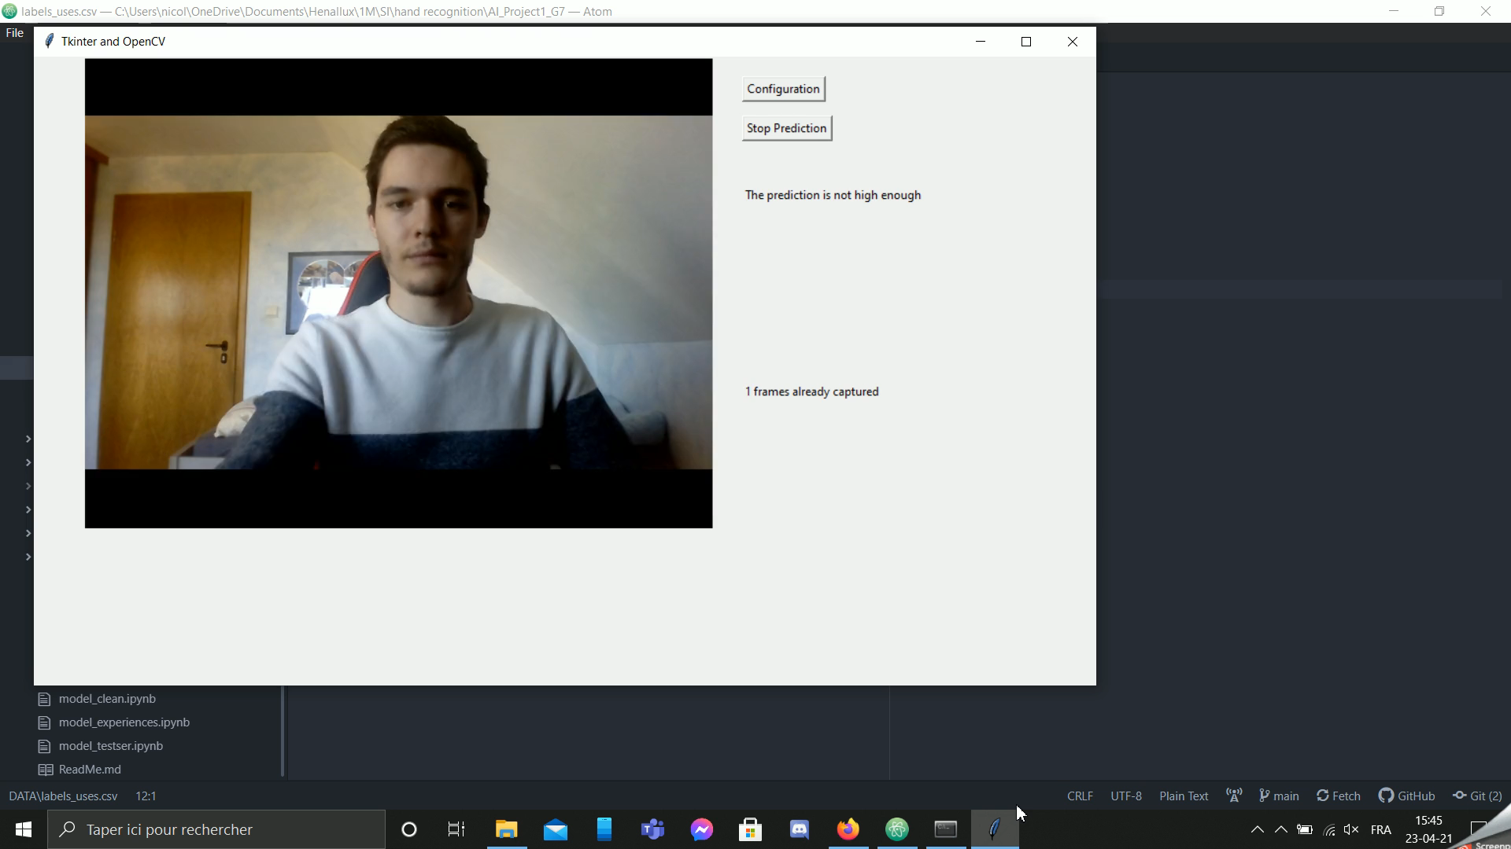

Slide 13
Limites
06

Slide 14
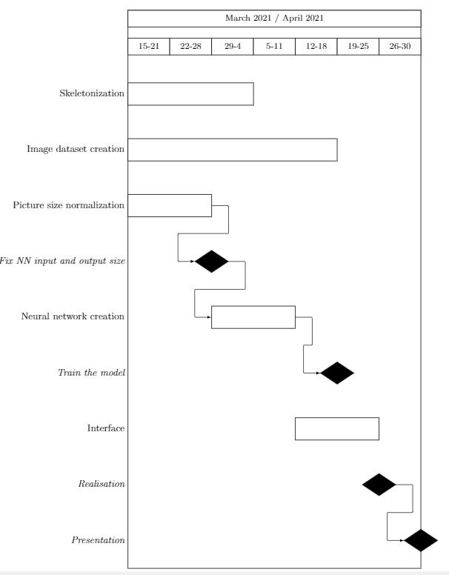
Gantt Diagram:

Slide 15

Thank You for your attention

